Slide 1

Smart Home Energy Management System
PRESENTED BY
BHARATHI SELVARAJ

Slide 2

Smart Home Energy Management System
1
2
3
Smart Device Management
- Main Classes:
1. Device
2. DeviceController
3. DeviceService
4. DeviceRepository
Module 1: Authentication and Role Management
- Main Classes:
1. UserAuthController
2. AuthService
3. UserRepository
Real Time Energy Tracking
- Main Classes:
1. UsageLog
2. EnergyTrackingController
3. EnergyTrackingService
4. UsageRepository
4
5
6
Analytics Dashboard
- Main Classes:
1. AnalyticsController
2. AnalyticsService
3. ChartGenerator
4. AnalyticsRepository
Scheduling and Automation
- Main Classes:
1. Schedule
2. SchedulerController
3. SchedulerService
4. NotificationService
5. SchedulerRepository
Recommendation System
- Main Classes:
1. Recommendation
2. RecommendationController
3. RecommendationService
4

Slide 3
module 1 review
Module 1 handles user authentication and role management.
It ensures only authorized users can securely access the system.
Core Classes & Their Responsibilities
🧑‍💻 1. UserAuthController
  Handles login and registration requests
  Receives user credentials from the frontend
  Sends requests to the service layer
⚙️ 2. AuthService
  Validates user credentials
  Handles authentication logic
  Manages role-based access control
🗄️ 3. UserRepository
  Communicates with the database
  Stores and retrieves user details
  Supports authentication operations

Slide 4
Smart Device Management
Key Functions
Main Components
Purpose
Outputs
  Manage all smart home devices
  Allow users to control devices (ON/OFF)
  Maintain real-time device status
  Add/Update/Delete device
  Fetch list of devices
  Control device operations
  Store and update device configurations
  DeviceController
  DeviceService
  DeviceRepository
  Device (Model)
  Device status updates
  Device list for dashboard
6

Slide 5


Workflow & Automation Overview
User Action Hub
  All device operations start here
  Direct interaction with appliances
Energy Data Source
  Generates device-level usage data
  Foundation for energy tracking
Step 1:
User logs in (Module 1 validates access)
Step 2:
User turns ON a device (Module 2 executes action)
Step 3:
Device usage is recorded (Module 3)
Step 4:
Usage data is analyzed (Module 4)
Step 5:
Automation or suggestion is generated (Module 5 & 6)
Automation Enabler
  Devicestate enables scheduling
  Supports automatic ON/OFF
Decision Driver
  Usage data feeds analytics
  Enablessmart recommendations

Slide 6
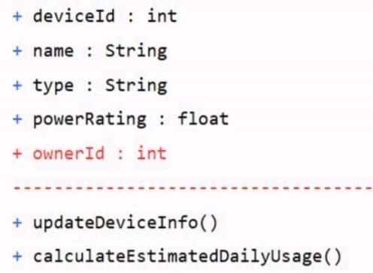
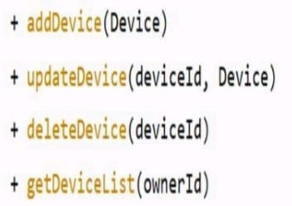
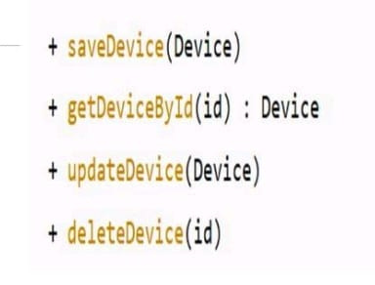
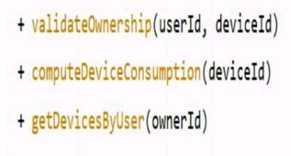
class diagram
DEVICE
DEVICECONTROLLER
DEVICEREPOSITORY
DEVICESERVICE
7

Slide 7


Step 1: User Interaction
  Authenticated user selects a smart device.
  Requests ON / OFF or configuration change.
Step 2: Controller Layer
DeviceController
  Accepts device request
  Validates user session (from Module 1)
  Forwards request to service layer
Class Activity Flow
Step 4: Repository Layer
DeviceRepository
  Stores updated device state
  Persists configuration in database
Step 3: Service Layer
DeviceService
  Applies business rules
  Updates device operational state
  Calculates power usage impact
Step 5: Response
  Updated device status sent to dashboard
  User receives real-time feedback

Slide 8
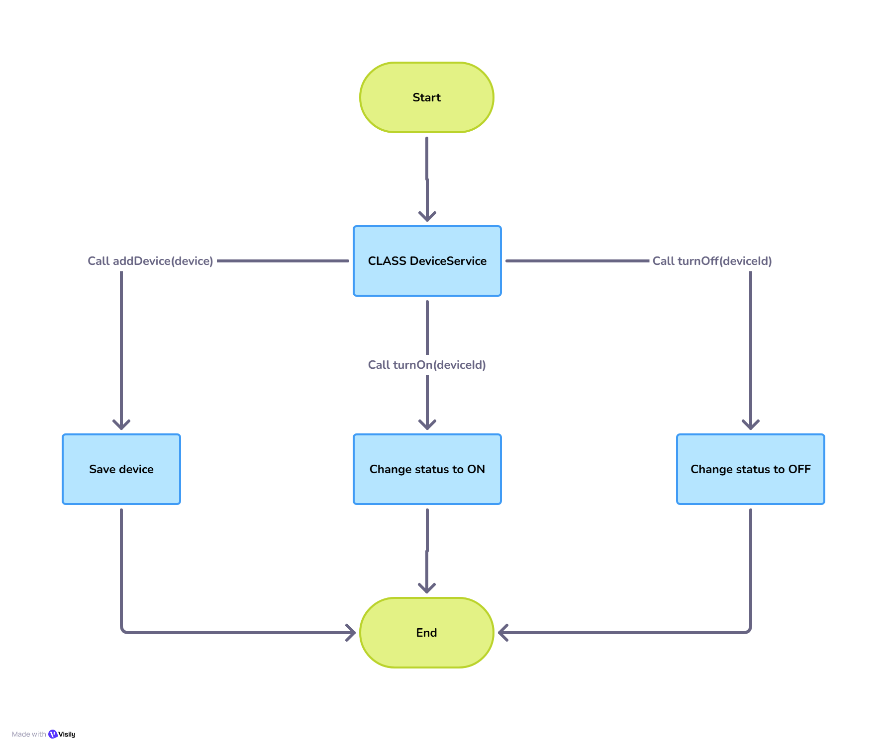
6

Slide 9
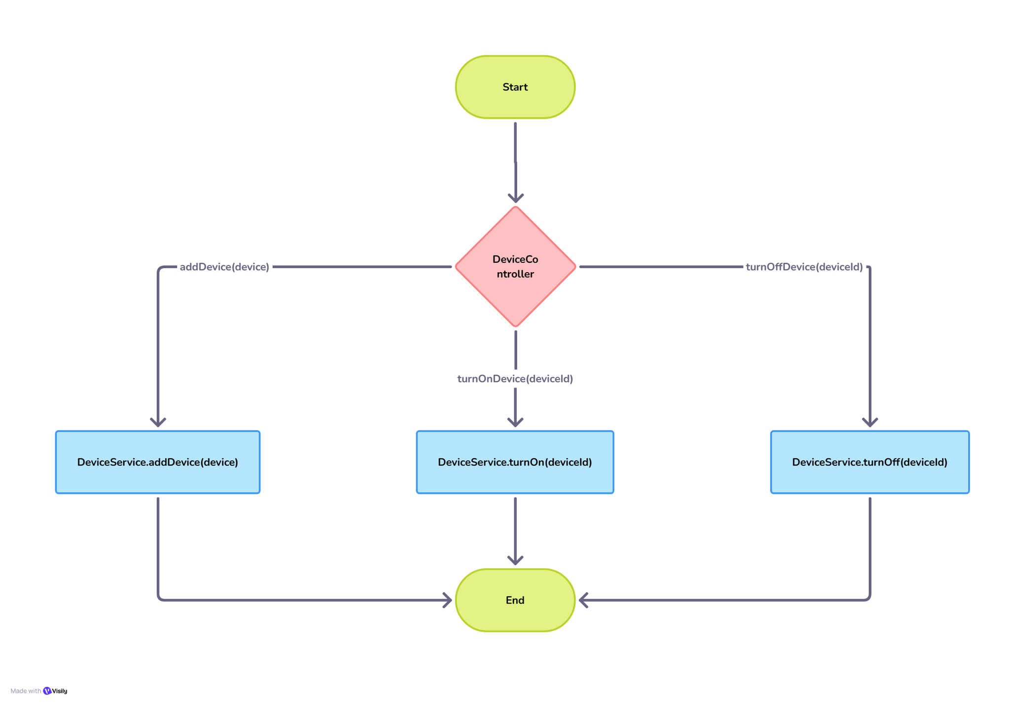

Slide 10
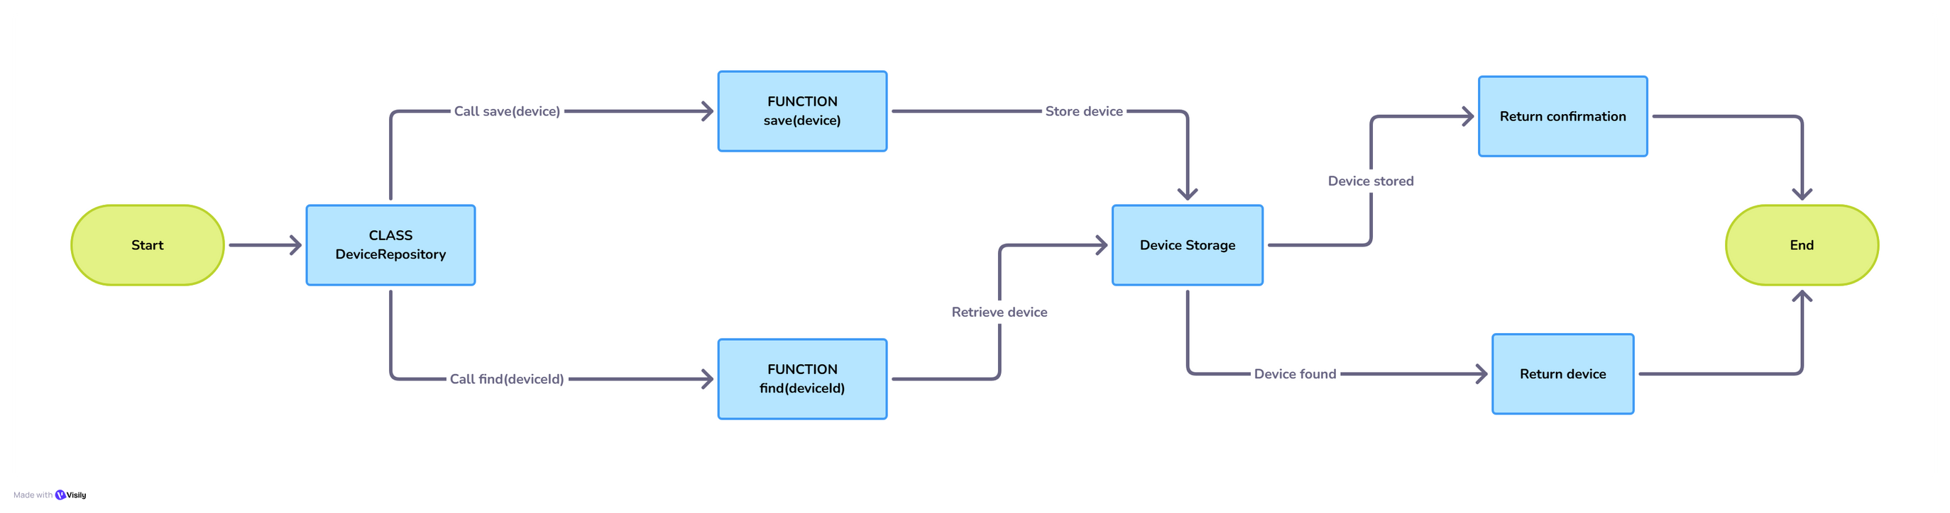

Slide 11
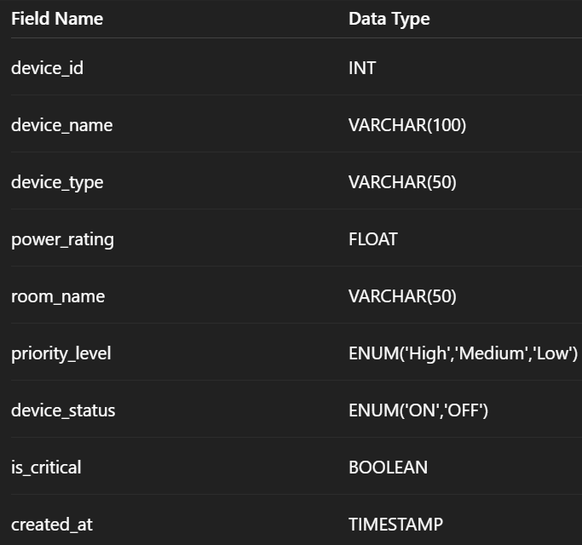
DEVICE REPOSITORY
6

Slide 12
The End

